Slide 1
Simple Keyword Private Information Retrieval
Weiran Liu
Alibaba Group
weiran.lwr@alibaba-inc.com

Slide 2
Outline
Introduction to Private Information Retrieval
01
PIR from Homomorphic Encryption
02
ChalametPIR: from PIR to Keyword PIR
03
Our Efficient Keyword PIR from Simple PIR
04

Slide 3
Outline
Introduction to Private Information Retrieval
01

Slide 4


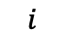
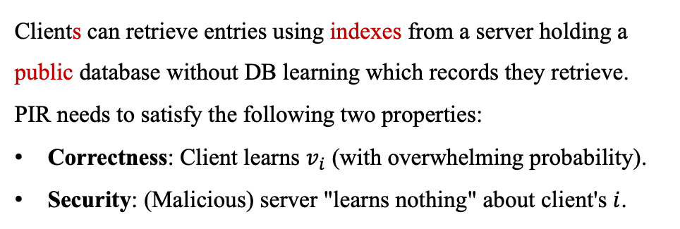
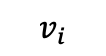
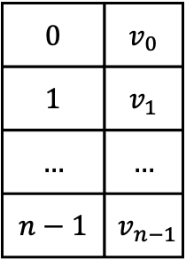
1.1 (Index) PIR Definition
Definition
Client
Server
Clients can retrieve entries using indexes from a server holding a public database without DB learning which records they retrieve.
PIR needs to satisfy the following two properties:
Correctness: Client learns $v_{i}$ (with overwhelming probability).
Security: (Malicious) server "learns nothing" about client's $i$.
$$0$$ | $$v_{0}$$
$$1$$ | $$v_{1}$$
$$…$$ | $$…$$
$$n−1$$ | $$v_{n−1}$$
$$i$$
Index PIR
$$v_{i}$$
Categories
①
①
③
②
②
④
Two-Server PIR [CKGS95] (Honest-Majority Setting)
Single-Server PIR [KO97] (Dishonest-Majority Setting)
[CKGS95] B. Chor, O. Goldreich, E. Kushilevitz, and M. Sudan. Private Information Retrieval. FOCS 1995, pp. 41-41. IEEE, 1995.
[KO97] E. Kushilevitz, and R. Ostrovsky. Replication is not Needed: Single Database, Computationally-private Information Retrieval. FOCS 1997, pp. 364-373. IEEE, 1997.

Slide 5
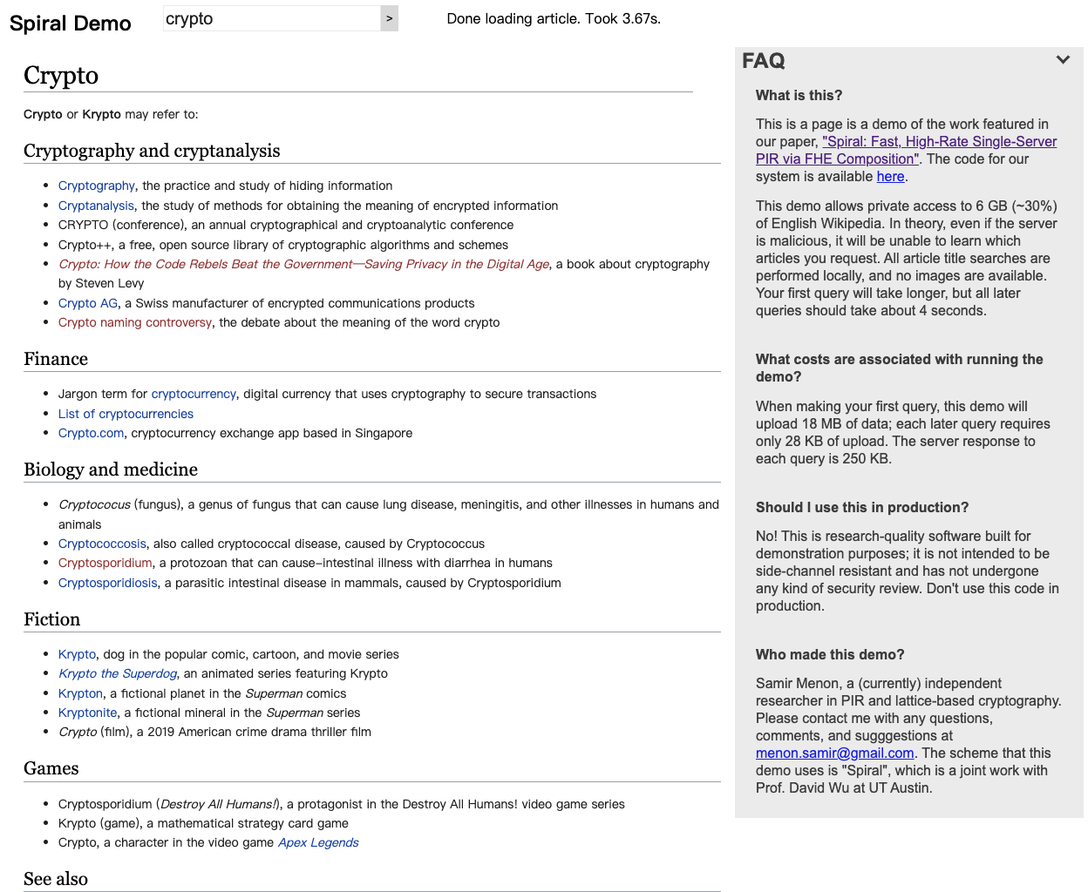
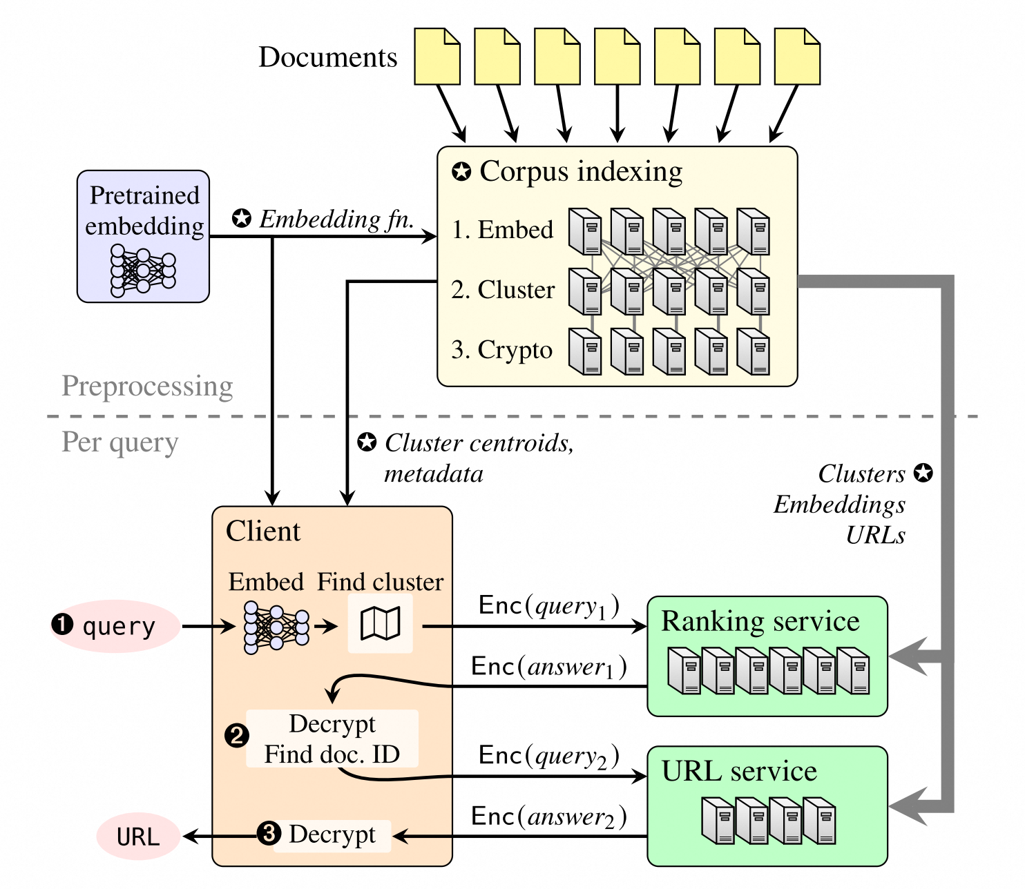
1.2 PIR Applications
Private Wikipedia
Private Web Search
https://spiralwiki.com/
﻿ https://github.com/ahenzinger/tiptoe/
[MW22] S. J. Menon, David J. Wu. Spiral: Fast, High-rate Single-server PIR via FHE Composition. S&P 2022, pp. 930-947. IEEE, 2022.
[HDCZ23] A. Henzinger, E. Dauterman, H. Corrigan-Gibbs, N. Zeldovich. Private Web Search with Tiptoe. SOSP 2023, pp. 396-416. 2023.

Slide 6
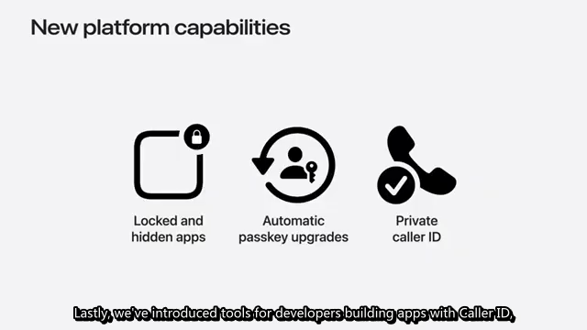
1.2 PIR Applications
https://developer.apple.com/documentation/sms_and_call_reporting/getting_up-to-date_calling_and_blocking_information_for_your_app

Slide 7
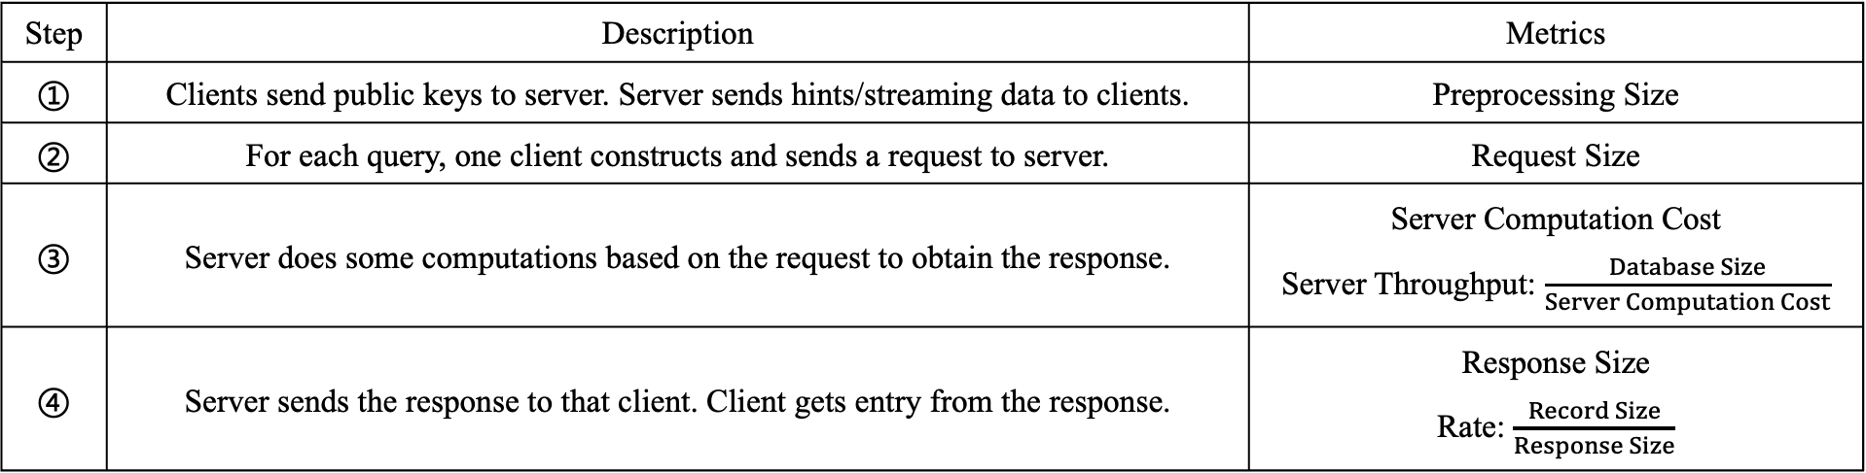
1.3 PIR Efficiency Metrics
① Server/Client Setup and Preprocessing
$$0$$ | $$v_{0}$$
$$1$$ | $$v_{1}$$
$$…$$ | $$…$$
$$n−1$$ | $$v_{n−1}$$
② Client Request
③ Computation
④ Server Response
Step | Description | Metrics
① | Clients send public keys to server. Server sends hints/streaming data to clients. | Preprocessing Size
② | For each query, one client constructs and sends a request to server. | Request Size
③ | Server does some computations based on the request to obtain the response. | Server Computation Cost Server Throughput: $\frac{Database Size}{Server Computation Cost}$
④ | Server sends the response to that client. Client gets entry from the response. | Response Size Rate: $\frac{Record Size}{Response Size}$

Slide 8
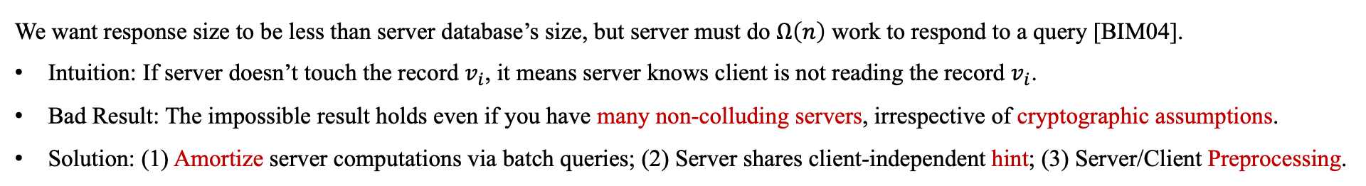
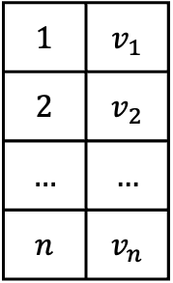
1.3 PIR Efficiency Metrics
Naïve Solution
Preprocessing Size
$$0$$ | $$v_{0}$$
$$1$$ | $$v_{1}$$
$$…$$ | $$…$$
$$n−1$$ | $$v_{n−1}$$
Request Size
Computation Cost
Response Size: $O\left(n\right)$
$$1$$ | $$v_{1}$$
$$2$$ | $$v_{2}$$
$$…$$ | $$…$$
$$n$$ | $$v_{n}$$
Impossible Result
We want response size to be less than server database’s size, but server must do $Ω\left(n\right)$ work to respond to a query [BIM04].
Intuition: If server doesn’t touch the record $v_{i}$, it means server knows client is not reading the record $v_{i}$.
Bad Result: The impossible result holds even if you have many non-colluding servers, irrespective of cryptographic assumptions.
Solution: (1) Amortize server computations via batch queries; (2) Server shares client-independent hint; (3) Server/Client Preprocessing.
[BIM04] A. Beimel, Y. Ishai, and T. Malkin. Reducing the Servers’ Computation in Private Information Retrieval: PIR with Preprocessing. Journal of Cryptology 17(2), pp. 125-151, 2004.

Slide 9
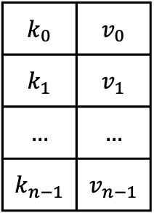

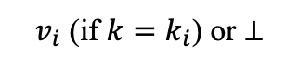
1.4 PIR Extensions: Keyword PIR
Keyword PIR Definition
Server holds a public set with $n$ key-value pairs $D=\left\{\left(k_{0},v_{0}\right),…,\left(k_{n−1},v_{n−1}\right)\right\}$ where $k_{i}∈{\left\{0,1\right\}}^{l}$. Each client retrieves by a keyword $k$.
$$k_{0}$$ | $$v_{0}$$
$$k_{1}$$ | $$v_{1}$$
$$…$$ | $$…$$
$$k_{n−1}$$ | $$v_{n−1}$$
$$k$$
Keyword PIR
$v_{i}$ (if $k=k_{i}$) or $⊥$
Perfect Hashing Solution
[BGN98] Suppose server can find a hash function $h:{\left\{0,1\right\}}^{l}→\left\{0,…,t−1\right\}$, where $t≥n$, such that $h$ is perfect for the $\left\{k_{0},…k_{n−1}\right\}$. A hash function is perfect for $\left\{k_{0},…k_{n−1}\right\}$ if its restriction to $\left\{k_{0},…k_{n−1}\right\}⊆{\left\{0,1\right\}}^{l}$ is one-to-one, i.e., there is no hash collision for $\left\{k_{0},…k_{n−1}\right\}$.
Assume $t=16$ and $n=10$. Server finds a hash function $h$ that is perfect for $\left\{k_{0},…k_{9}\right\}$. Server puts all $k_{i}||v_{i}$ into an array with size $t=16$.
Server and client run the Index PIR with query $i=h\left(k\right)$ and client returns $v_{i}$ if $k=k_{i}$ in the response $k_{i}||v_{i}$ or $⊥$ otherwise.
 | $$k_{7}||v_{7}$$ | $$k_{3}||v_{3}$$ | $$k_{0}||v_{0}$$ |  | $$k_{5}||v_{5}$$ | $$k_{8}||v_{8}$$ | $$k_{1}||v_{1}$$ |  | $$k_{2}||v_{2}$$ |  | $$k_{9}||v_{9}$$ | $$k_{6}||v_{6}$$ |  |  | $$k_{4}||v_{4}$$
Finding such $h$ is non-trivial. We will later show advanced methods for constructing efficient Keyword PIR with/without using Index PIR.
[BGN98] B. Chor, N. Gilboay, and M. Naorz. Private Information Retrieval by Keywords. IACR Cryptology ePrint Archive, 1998, https://eprint.iacr.org/1998/003.ps.

Slide 10

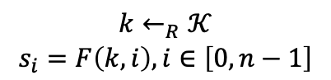


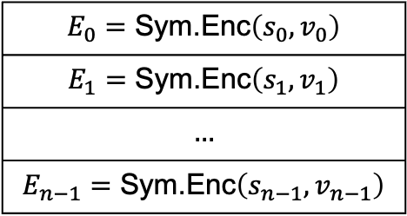
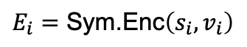

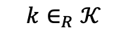
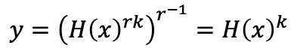
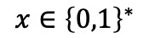

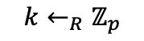
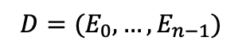
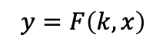


1.4 PIR Extensions: Symmetric PIR
Symmetric PIR Definition
Server holds a private database with $n$ entries $D=\left\{v_{0},v_{1},…,v_{n−1}\right\}$. Each client learns one entry in one query. Privacy is Symmetric.
Oblivious PRF
$$k←_{R}ℤ_{p}$$
$$x∈{\left\{0,1\right\}}^{∗}$$
OPRF
$$k∈_{R}𝒦$$
$$r←_{R}ℤ_{p}$$
$$H{\left(x\right)}^{r}$$
$$H{\left(x\right)}^{rk}$$
$$y=F\left(k,x\right)$$
$$y={\left({H\left(x\right)}^{rk}\right)}^{r^{−1}}=H{\left(x\right)}^{k}$$
Oblivious PRF [NR97]
OPRF based on DDH [FIPR05]
OPRF Solution
$$k←_{R}𝒦$$
$$s_{i}=F\left(k,i\right),i∈\left[0,n−1\right]$$
$$i$$
PIR
$$D=(E_{0},…,E_{n−1})$$
$$E_{0}=\text{Sym}\text{.}\text{Enc}\left(s_{0},v_{0}\right)$$
$$E_{1}=\text{Sym}\text{.}\text{Enc}\left(s_{1},v_{1}\right)$$
$$…$$
$$E_{n−1}=\text{Sym}\text{.}\text{Enc}\left(s_{n−1},v_{n−1}\right)$$
$$E_{i}=\text{Sym}\text{.}\text{Enc}\left(s_{i},v_{i}\right)$$
$$i$$
OPRF
$$k$$
$$s_{i}=F\left(k,i\right)$$
[NR97] M. Naor and O. Reingold. Number-theoretic Constructions of Efficient Pseudorandom Functions. FOCS 1997, pp. 458-467.
[FIPR05] M. J. Freedman, Y. Ishai, B. Pinkas, O. Reingold. Keyword Search and Oblivious Pseudorandom Functions. TCC 2005, pp. 303-324.

Slide 11
Outline
PIR from Learning With Error Assumption
02

Slide 12
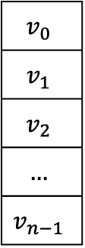
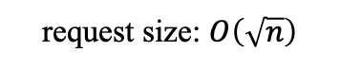
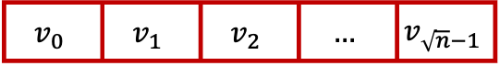
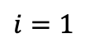

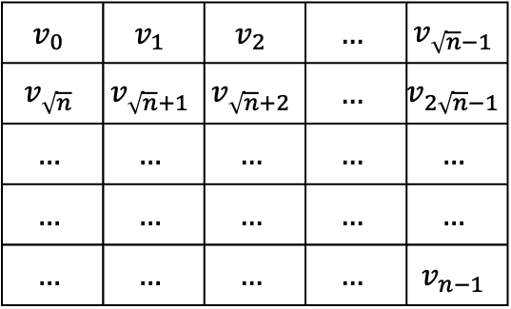
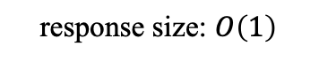
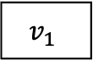
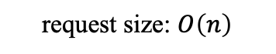
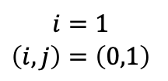
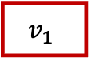
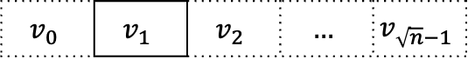


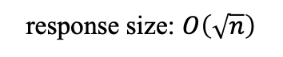
2.1 PIR with Additive Homomorphic Encryption
PIR Construction Paradigm
0
1
0
…
0
0
1
0
…
0
$$v_{0}$$
$$v_{1}$$
$$v_{2}$$
$$…$$
$$v_{n−1}$$
inner-product
request size: $O\left(n\right)$
$$⊙$$
$$i=1$$
$=$
response size: $O\left(1\right)$
$$v_{1}$$
$$v_{1}$$
Hierarchical PIR
0
1
0
…
0
0
1
0
…
0
$$v_{0}$$ | $$v_{1}$$ | $$v_{2}$$ | $$…$$ | $$v_{\sqrt{n}−1}$$
$$v_{\sqrt{n}}$$ | $$v_{\sqrt{n}+1}$$ | $$v_{\sqrt{n}+2}$$ | $$…$$ | $$v_{2\sqrt{n}−1}$$
$$…$$ | $$…$$ | $$…$$ | $$…$$ | $$…$$
$$…$$ | $$…$$ | $$…$$ | $$…$$ | $$…$$
$$…$$ | $$…$$ | $$…$$ | $$…$$ | $$v_{n−1}$$
$$i=1$$
$$\left(i,j\right)=\left(0,1\right)$$
request size: $O\left(\sqrt{n}\right)$
$$⊙$$
$=$
response size: $O\left(\sqrt{n}\right)$
$$v_{0}$$ | $$v_{1}$$ | $$v_{2}$$ | $$…$$ | $$v_{\sqrt{n}−1}$$
$$v_{0}$$ | $$v_{1}$$ | $$v_{2}$$ | $$…$$ | $$v_{\sqrt{n}−1}$$
[KO97] E. Kushilevitz, and R. Ostrovsky. Replication is not Needed: Single Database, Computationally-private Information Retrieval. FOCS 1997, pp. 364-373. IEEE, 1997.

Slide 13

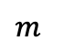



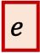
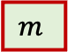


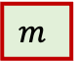
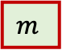
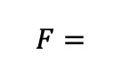



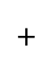

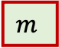
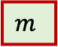

2.2 SealPIR with RLWE
Ring LWE
Existing efficient fully/somewhat homomorphic encryptions are based on Ring Learning With Errors (RLWE) structure [FV12,CGGI20].
$$m$$
padding
$$e$$
$$m$$
padding
$$e$$
$⊠$
$$m$$
padding
$$e$$
RLWE Ciphertext Format
$$m$$
padding
$$e$$
$$m$$
padding
$$e$$
$F=$
m
$$m$$
$$e$$
Important metric: ciphertext expansion factor $F$
Limited Operations on RLWE Ciphertext
Ciphertext-Ciphertext Addition
Operations
$+$
$=$
Plaintext-Ciphertext Multiplication
$×$
$=$
Ciphertext-Ciphertext Multiplication
$×$
$=$
[FV] J. Fan, F. Vercauteren. Somewhat Practical Fully Homomorphic Encryption. IACR Cryptology ePrint Archive, 2012, https://eprint.iacr.org/2012/144.pdf.
[CGGI20] I. Chillotti, N. Gama, M. Georgieva, M. Izabachène. TFHE: Fast Fully Homomorphic Encryption over the Torus. Journal of Cryptology 33, no. 1 (2020): 34-91.

Slide 14
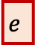
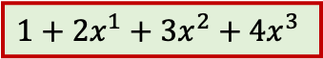
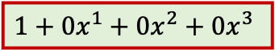

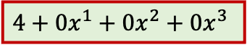


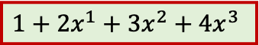
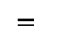
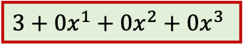
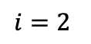






2.2 SealPIR with RLWE
Basic Idea
All elements except one are the encryption of 0. Client encrypts the request index and server expands it into a vector.
0
2
1
$$i=2$$
$$\text{Expan}\text{d}$$
2
$$=$$
0
$$…$$
We can do that since FHE supports arbitrary operations. Naïve way needs high-depth circuits with large FHE parameters.
RLWE Plaintext
$$m_{1}$$
$$e$$
$$1+0x^{1}+0x^{2}+0x^{3}$$
$$2+0x^{1}+0x^{2}+0x^{3}$$
$$m_{1}+0x^{1}+0x^{2}+0x^{3}+…+0x^{N}$$
$$\text{Expand}$$
$$1+2x^{1}+3x^{2}+4x^{3}$$
$$=$$
Substitute Operation: Operation with low noise [GHS12].
$$3+0x^{1}+0x^{2}+0x^{3}$$
$$\text{Subs}$$
$$1+2x^{1}+3x^{2}+4x^{3}$$
with 4 =
$$1+2x^{4}+3x^{8}+4x^{12}$$
$$4+0x^{1}+0x^{2}+0x^{3}$$
[GHS12] C. Gentry, S. Halevi, N. P. Smart. Fully Homomorphic Encryption with Polylog Overhead. EUROCRYPT 2012, pp. 465-482.

Slide 15



















2.2 SealPIR with RLWE
Request Compression
row
1
$$m_{1}$$
$$m_{2}$$
$$m_{3}$$
$$1+0x^{1}+0x^{2}$$
request size: $O\left(2\right)$
0
$$m_{4}$$
$$m_{5}$$
$$m_{6}$$
$$i=2$$
$$0+1x^{1}+0x^{2}$$
0
$$m_{7}$$
$$m_{8}$$
$$m_{9}$$
col
0
1
0
response size: $O\left(1\right)$
$+$
$$m_{2}$$
$$m_{2}$$
void multiply_power_of_X(const Ciphertext &encrypted, Ciphertext &destination, uint32_t index, const SEALContext& context) { const auto &context_data = context.first_context_data(); auto &parms = context_data->parms(); auto coeff_mod_count = parms.coeff_modulus().size(); auto coeff_count = parms.poly_modulus_degree(); auto encrypted_count = encrypted.size(); destination = encrypted; for (uint32_t i = 0; i < encrypted_count; i++) { for (uint32_t j = 0; j < coeff_mod_count; j++) { seal::util::negacyclic_shift_poly_coeffmod(encrypted.data(i) + (j * coeff_count), coeff_count, index, parms.coeff_modulus()[j], destination.data(i) + (j * coeff_count)); } } }
There is an error in Figure 4 in the conference version of SealPIR paper.
substitute $x^{index}$
[ACLS18] S. Angel, H. Chen, K. Laine, S. Setty. PIR with Compressed Queries and Amortized Query Processing. S&P 2018, pp. 962-979.

Slide 16






























2.2 SealPIR with RLWE
Ciphertext Multiplication
$$m_{1}$$
$$m_{2}$$
$$m_{3}$$
$×$
1
$$m_{1}$$
$$m_{2}$$
$$m_{3}$$
$$m_{4}$$
$$m_{5}$$
$$m_{6}$$
$×$
0
$×$
$×$
$×$
$$m_{7}$$
$$m_{8}$$
$$m_{9}$$
$×$
0
0
1
0
$+$
$+$
0
1
0
$$m_{2}$$
1st dimension
2nd dimension
The 2nd dimension needs ciphertext-ciphertext multiplication, involving large ciphertext operations ($F^{2}=100$)
Reduce Computation
$$m_{i}$$
$…$
Split ciphertexts as $F$ plaintexts
Decrypt $F$ times to get split ciphertexts
$×$
Multiply each of $F$ plaintexts
0
$$m_{2}$$
Merge $F$ plaintexts as one ciphertext
$…$
$$m_{2}$$
Trade-offs [ACLS21]!
[ACLS18] S. Angel, H. Chen, K. Laine, S. Setty. PIR with Compressed Queries and Amortized Query Processing. S&P 2018, pp. 962-979.
[ALP+21] A. Ali, T. Lepoint, S. Patel, et al. Communication-computation Trade-offs in PIR. USENIX Security 2021, pp. 1811-1828.

Slide 17































2.3 FrodoPIR: PIR with LWE
Challenges for PIR with RLWE
Hard to Understand: We do not even introduce the details of polynomial operation module $X^{N}+1$ and Substitution operations.
Hard to Implement: In real-world applications, cryptographers need to handle engineering works, since engineers cannot do anything.
Hard to Deploy: It seems challenging to let non-expert customers believe that the solution is secure without understanding all details.
Hard to Change: Undergraduate students in Computer Science may learn Paillier Additive Homomorphic Encryption, but it is slow.
Can we turn back to PIR with additive homomorphic encryption using a more efficient and easy-to-understand encryption scheme?
Regev Encryption
$$\vec{a}$$
$$b$$
$$m$$
$$m′$$
$$m+m′$$
$$m$$
$$b=\sum_{i=0}^{N−1}{a_{i}s_{i}}+e+∆m$$
$$+$$
$$=$$
$$=$$
$$\left(a_{0},…,a_{N−1},b\right)$$
$$\vec{s}$$
$$\vec{s}$$
$$\vec{s}$$
$$\vec{s}$$
Addition
$$a_{i}←_{R}ℤ_{q}$$
$$b∈ℤ_{q}$$
Small Noise
Encryption
$$m$$
$$γ∙m$$
$$γ$$
$$∙$$
$$=$$
$$b$$
$$−$$
$$\vec{a}$$
$$∙$$
$$\vec{s}$$
$$=$$
$$∆m+e\underset{→}{\left\lfloor \left.∙\right\rceil \right.}m$$
$$\vec{s}$$
$$\vec{s}$$
Decryption
Constant Multiplication
[Reg09] O. Regev. On Lattices, Learning With Errors, Random Linear Codes, and Cryptography. Journal of the ACM, 56, no. 6 (2009): 1-40.

Slide 18





























2.3 FrodoPIR: PIR with LWE
Server Side
0
1
0
…
0
$$D$$
$${\vec{a}}_{0}$$
$${\vec{a}}_{1}$$
$${\vec{a}}_{2}$$
$$…$$
$${\vec{a}}_{n−1}$$
$$v_{0}$$
$$v_{1}$$
$$v_{2}$$
$$…$$
$$v_{n−1}$$
$$b_{0}$$
$$b_{1}$$
$$b_{2}$$
$$…$$
$$b_{n−1}$$
$$v_{0}$$
$$v_{1}$$
$$v_{2}$$
$$…$$
$$v_{n−1}$$
0
$$v_{1}$$
0
…
0
$$∙$$
$$=$$
$$∙$$
$$∙$$
$$=$$
Client LWE ciphertexts
(each encrypts one bit)
random $n×N$ matrix
(each entry in $ℤ_{q}$)
message dependent vector
(each entry in $ℤ_{q}$)
Server Response
(can be further added)
Client Side
$${\vec{a}}_{0}$$
$${\vec{a}}_{1}$$
$${\vec{a}}_{2}$$
$$…$$
$${\vec{a}}_{n−1}$$
$$v_{0}$$
$$v_{1}$$
$$v_{2}$$
$$…$$
$$v_{n−1}$$
inner-product
$$b_{0}$$
$$b_{1}$$
$$b_{2}$$
$$…$$
$$b_{n−1}$$
$$v_{0}$$
$$v_{1}$$
$$v_{2}$$
$$…$$
$$v_{n−1}$$
$$b$$
$$−$$
$$\vec{a}$$
$$⊙$$
$$\vec{s}$$
$$=$$
$$∙$$
$$−$$
$$∙$$
$$⊙$$
$$\vec{s}$$
Main Observations:
Compute $DB∙A$ involves 99.9% of the work.
$A$ is random and can be generated with a seed.
All can be done using unsigned int operations.
the same random matrix

Slide 19









































2.3 FrodoPIR: PIR with LWE
Preprocessing Phase
$$A=PRG\left(μ\right)$$
$$DB$$
$${\vec{a}}_{0}$$
$${\vec{a}}_{1}$$
$${\vec{a}}_{2}$$
$$…$$
$${\vec{a}}_{n−1}$$
$$v_{0}$$
$$v_{1}$$
$$v_{2}$$
$$…$$
$$v_{n−1}$$
$$A$$
$$M$$
$$∙$$
$$=$$
$$∙$$
$$=$$
$$\vec{s}$$
$$∙$$
$$=$$
$$b$$
$$N×ℓ$$
$$N×n$$
$$n×ℓ$$
$$1×N$$
$$N×n$$
$$1×n$$
Online Phase
$$\tilde{b}$$
$$DB$$
$$=$$
$$b$$
$$+$$
$$e$$
$$+$$
$$\left(0,1,…,0\right)$$
$$1×n$$
$$M$$
$$\tilde{b}$$
$$∙$$
$$=$$
$$\tilde{c}$$
$$\tilde{c}$$
$$−$$
$$\vec{s}$$
$$∙$$
$$1×ℓ$$
$$=$$
$${∆v}_{i}$$
Query Size
$O\left(n\right)$!
Server Side
Client Side
[DPC23] A. Davidson, G. Pestana, S. Celi. FrodoPIR: Simple, Scalable, Single-server Private Information Retrieval. PETS 2023.

Slide 20

2.4 SimplePIR: Hierarchial FrodoPIR
[7A] FrodoPIR: Simple, Scalable, Single-Server Private Information Retrieval, 11:58, available at https://www.youtube.com/watch?v=-zDuKWz-u4A.

Slide 21
























2.4 SimplePIR: Hierarchial FrodoPIR
0
1
0
…
0
$$D_{0}$$ | … | $$D_{\sqrt{n}−1}$$
$${\vec{a}}_{0}$$
$${\vec{a}}_{1}$$
$${\vec{a}}_{2}$$
$$…$$
$${\vec{a}}_{\sqrt{n}−1}$$
$$D_{0}$$ | … | $$D_{\sqrt{n}−1}$$
$$b_{0}$$
$$b_{1}$$
$$b_{2}$$
$$…$$
$$b_{n−1}$$
$$D_{0}$$ | … | $$D_{\sqrt{n}−1}$$
0Z
$$v_{1}$$
0
…
0
$$∙$$
$$=$$
$$∙$$
$$∙$$
$$=$$
random $\sqrt{n}×N$ matrix
message dependent vector
$$A=PRG\left(μ\right)$$
$$DB$$
$$M$$
$$A$$
$$∙$$
$$=$$
$$\vec{s}$$
$$∙$$
$$=$$
$$b$$
$$N×\sqrt{n}$$
$$\sqrt{n}×\left(\sqrt{n}×ℓ\right)$$
$$N×\left(\sqrt{n}×ℓ\right)$$
$$1×N$$
$$N×\sqrt{n}$$
$$1×\sqrt{n}$$
[HHC+23] A. Henzinger, et al. One Server for the Price of Two: Simple and Fast Single-server Private Information Retrieval. USENIX Security 2023, pp. 3889-3905. 2023.

Slide 22
Outline
ChalametPIR: from PIR to Keyword PIR
03

Slide 23

3.1 General Construction using Cuckoo Hash
Cuckoo Hash Definition
Map $n$ elements $\left\{k_{0},k_{1},…,k_{n−1}\right\}$ into $b=εn$ (where $ε=O\left(1\right)$) bins using $κ$ hash functions such that each bin only contains one element.
$$k_{0}$$ | $$k_{1}$$ | $$k_{2}$$ | $$k_{3}$$ | $$k_{4}$$ | $$k_{5}$$ | $$k_{6}$$ | $$k_{7}$$ | $$k_{8}$$ | $$k_{9}$$
$$k_{9}$$ | $$k_{2}$$ | $$k_{6}$$ | $$⊥$$ | $$k_{0}$$ | $$k_{7}$$ | $$k_{1}$$ | $$⊥$$ | $$k_{5}$$ | $$k_{8}$$ | $$⊥$$ | $$k_{4}$$ | $$k_{4}$$ | $$⊥$$ | $$⊥$$
0 | 1 | 2 | 3 | 4 | 5 | 6 | 7 | 8 | 9 | 10 | 11 | Stash
Cuckoo Hash Algorithm
Suppose we have $κ$ hash functions $h_{1},⋯,h_{κ}:{\left\{0,1\right\}}^{σ}→\left[1,b\right]$.
An element $e$ is inserted into a bin $B_{h_{1}}\left(e\right)$.
Any prior contents $o$ of $B_{h_{1}}\left(e\right)$ are evicted to a new bin $B_{h_{i}\left(o\right)}$, using $h_{i}$ to decide the location, $h_{i}\left(o\right)≠h_{i}\left(e\right)$ for $i∈\left[1,κ\right]$.
The procedure is repeated until no more evictions are necessary, or until a threshold number of relocations has been performed.
If the threshold number of relocations is reached, the last element is put in a special stash.
While introduced by Pagh and Rodler [PR04], many follow-up works have studied further properties and variants, even in 2023 [Yeo23].
[PR04] R. Pagh,, and F. F. Rodler. Cuckoo Hasing. Journal of Algorithms, 51(2), pp. 122-144, 2004.
[Yeo23] Kevin Yeo. Cuckoo Hashing in Cryptography: Optimal Parameters, Robustness and Applications. To appear in CRYPTO 2023.

Slide 24







3.1 General Construction using Cuckoo Hash
Cuckoo Hash Example
 | $$k_{0}$$ | $$k_{1}$$ | $$k_{2}$$ | $$k_{3}$$ | $$k_{4}$$
$$h_{1}(∙)$$ | 4 | 5 | 4 | 1 | 2
$$h_{2}(∙)$$ | 5 | 0 | 3 | 1 | 3
$$h_{3}(∙)$$ | 2 | 5 | 0 | 2 | 1
Assume $κ=3$ hash functions, $b=6$ bins, insert $n=5$ items.
Hash values for all elements under all hashes are given in the table.
Insert $k_{0}$
 |  |  |  | $$k_{0}^{h_{1}}$$
0 | 1 | 2 | 3 | 4 | 5 | Stash
Insert $k_{1}$
 |  |  |  | $$k_{0}^{h_{1}}$$ | $$k_{1}^{h_{1}}$$
0 | 1 | 2 | 3 | 4 | 5 | Stash
Insert $k_{2}$
$$k_{1}^{h_{2}}$$ |  |  |  | $$k_{2}^{h_{1}}$$ | $$k_{0}^{h_{2}}$$
0 | 1 | 2 | 3 | 4 | 5 | Stash
Insert $k_{3}$
$$k_{1}^{h_{2}}$$ | $$k_{3}^{h_{1}}$$ |  |  | $$k_{2}^{h_{1}}$$ | $$k_{0}^{h_{2}}$$
0 | 1 | 2 | 3 | 4 | 5 | Stash
Insert $k_{4}$
$$k_{1}^{h_{2}}$$ | $$k_{3}^{h_{1}}$$ | $$k_{4}^{h_{1}}$$ | $$⊥$$ | $$k_{2}^{h_{1}}$$ | $$k_{0}^{h_{2}}$$ | $$⊥$$ | $$⊥$$
0 | 1 | 2 | 3 | 4 | 5 | Stash

Slide 25







3.1 General Construction using Cuckoo Hash
Cuckoo Hash Keyword PIR
[ALP+21] Server generates cuckoo hash functions using the data dependent key generation $\text{Cuckoo}\text{.}\text{KeyGen}(D)$ and builds a cuckoo hash table for its database using the insertion algorithm $\text{Cuckoo}\text{.}\text{Insert}$. Server simply rerun the procedure if the stash is not empty. To query an item $k$, the client executes $κ$ PIR queries for items $h_{j}\left(κ\right), j∈\left[1,κ\right]$ for the database that contains the cuckoo hash table.
Pre-processing: ﻿Server generates parameters for the cuckoo hash that will fit its input $\left(h_{1},h_{2},…,h_{κ}\right)←\text{Cuckoo}\text{.}\text{KeyGen}(D)$. It ﻿initializes the cuckoo hash table, invoking $\text{Cuckoo}\text{.}\text{Insert}(k_{i}||v_{i})$ for all $\left(k_{i},v_{i}\right)∈D$. It sends to the client ${\left\{h_{j}\right\}}_{j∈\left[1,κ\right]}$.
Request: ﻿Client computes $q_{j}^{k}←\text{PIR}\text{.}\text{Request}\left(h_{j}\left(k\right)\right)$ for $j∈\left[1,κ\right]$.
Response: ﻿Server run $r_{j}^{k}←\text{PIR}\text{.}\text{Response} (q_{j}^{k})$ for $j∈\left[κ\right]$. Client checks if any of $r_{j}^{k}$, $j∈\left[κ\right]$contains $k$. If the items is present, the client outputs it and otherwise, the client outputs $⊥$.
$$k_{2}^{h_{2}}||v_{2}$$
$$k_{4}^{h_{1}}||v_{4}$$
$$k_{5}^{h_{1}}||v_{5}$$
$$Δ$$
$$k_{3}^{h_{1}}||v_{3}$$
$$k_{1}^{h_{2}}||v_{1}$$
$$k_{1}$$ | $$v_{1}$$
$$k_{2}$$ | $$v_{2}$$
$$k_{3}$$ | $$v_{3}$$
$$k_{4}$$ | $$v_{4}$$
$$k_{5}$$ | $$v_{5}$$
Request for $h_{j}\left(k\right),j∈\left[1,3\right]$
$$\left(h_{1},h_{2},h_{3}\right)←\text{Cuckoo}\text{.}\text{KeyGen}(D)$$
$\text{Cuckoo}\text{.}\text{Insert}(k_{i}||v_{i})$
Check if $k=k_{i}$ for any $k_{i}^{h_{j}}||v_{i}$
[ALP+21] A. Ali, T. Lepoint, S. Patel, et al. Communication-computation Trade-offs in PIR. USENIX Security 2021, pp. 1811-1828.

Slide 26















3.2 Specific Construction using Equality Operators
Basic Idea
$$k$$ | $$=_{?}$$ | $$k_{0}$$
$$k$$ | $$=_{?}$$ | $$k_{1}$$
$$k$$ | $$=_{?}$$ | $$k_{2}$$
… | $$=_{?}$$ | $$…$$
$$k$$ | $$=_{?}$$ | $$k_{n−1}$$
0
1
0
…
0
$$v_{0}$$
$$v_{1}$$
$$v_{2}$$
$$…$$
$$v_{n−1}$$
request size: $O\left(1\right)$
$$k$$
$$k$$
$×$
$+$
$=$
1
$$v_{1}$$
response size: $O\left(1\right)$
1
$$v_{1}$$
Naïve Solution
Challenges using naïve solution into Keyword PIR:
Most (F)HE schemes support operations in $ℤ_{p}$ instead of Binary operations. One can make $p=2$ but it is not concretely efficient.
The multiplication depth is $ℓ−1$ (for $ℓ$-bit keywords). One can reduce to $\log\left(ℓ−1\right)$, but it is still not acceptable for (F)HE.
Client query contains $ℓ$ ciphertexts. One can hash to compress keys, but $ℓ≈σ+\log{n}$ to avoid possible collisions.
$$x$$ | $$x_{ℓ−1}$$ | $$x_{ℓ−2}$$ | $$…$$ | $$x_{2}$$ | $$x_{1}$$ | $$x_{0}$$
 | $$⊕$$ | $$⊕$$ | $$…$$ | $$⊕$$ | $$⊕$$ | $$⊕$$
$$\overline{y}$$ | $${\overline{y}}_{ℓ−1}$$ | $${\overline{y}}_{ℓ−2}$$ | $$…$$ | $${\overline{y}}_{2}$$ | $${\overline{y}}_{1}$$ | $${\overline{y}}_{0}$$
$$⨀$$
$$e$$
Equality Operators with Binary Operations

Slide 27








3.2 Specific Construction using Equality Operators
Solution 1: Constant-Weight Code
$$CW(x)$$ | $$x_{ℓ−1}$$ | $$x_{ℓ−2}$$ | $$…$$ | $$x_{2}$$ | $$x_{1}$$ | $$x_{0}$$
 |  | $$⊕$$ | $$…$$ |  |  | $$⊕$$
$$CW(y)$$ | $$0$$ | $$1$$ | $$…$$ | $$0$$ | $$0$$ | $$1$$
[MK22] A binary constant-weight code is a error correcting code with length (bit-length of codewords) $m$ and size (number of distinct codewords) $n$ where all codewords share the same Hamming weight $k$ and all codewords are binary strings. ﻿Given (fixed) length $m$ and Hamming weight of $k$, the size of the constant-weight code is $\left({m \atop k}\right)$.
For $m=6,k=2$, possible codewords: $000011,000101,000110…$
$⨀$ ($k−1$ times)
$$e$$
Equality Operators with constant-weight code
Solution 2: Fermat's Little Theorem
$$17−1$$
$$1$$ |  | $$12$$ |  | $$4$$ |  | 1 |  | $$0$$
$$1$$ |  | $$12$$ |  | $$7$$ |  | 1 |  | $$0$$
$$1$$ | $$−$$ | $$12$$ | $$−$$ | $$12$$ | $$=$$ | 1 | $$−$$ | $$1$$
… |  | $$…$$ |  | $$…$$ |  | $$…$$ |  | $$…$$
$$1$$ |  | $$12$$ |  | $$10$$ |  | 1 |  | $$0$$
Fermat's little theorem implies that if $p$ is a prime number and $a$ is a number not divisible by $p$, then $a^{\left(p−1\right)}≡1 \left(\text{mod} p\right)$. This means
$${\left(k−k_{i}\right)}^{\left(p−1\right)}=\left\{\begin{matrix}0 & \text{if} k=k_{i} \\ 1 & \text{otherwise}\end{matrix}\right.$$
One can further flip results by computing its 1's complement.
Equality Operators with Fermat's Little Theorem ($k=12,p=17$)
[MK22] R. A. Mahdavi, F. Kerschbaum. Constant-weight PIR: Single-round Keyword PIR via Constant-weight Equality Operators. USENIX Security 2022, pp. 1723-1740. 2022.
[IAG22] I. Ahmad, D. Agrawal, A. E. Abbadi, T. Gupta. Pantheon: Private Retrieval from Public Key-value Store. VLDB Endowment 16 (4): 643-656. 2022.

Slide 28


3.3 Specific Construction using OKVS
Basic Idea
Given key-value pairs $\left\{\left(k_{0},v_{0}\right),…,\left(k_{n−1},v_{n−1}\right)\right\}$, server interpolates two polynomials, one for indicating match, one for retrieving value.
$f\left(x\right)=x^{n}+a_{n−1}x^{n−1}+…+a_{1}x+a_{0}$ such that $f\left(k\right)=0$ when $k=k_{i}$, otherwise $f\left(k\right)≠0$.
$g\left(x\right)=x^{n}+b_{n−1}x^{n−1}+…+b_{1}x+b_{0}$ such that $g\left(k\right)=v_{i}$ when $k=k_{i}$, otherwise $g\left(k\right)=R$.
Each client makes a query with an homomorphically encrypted $k$. Server obliviously evaluates two polynomials. Client decrypts the results.
Construction
$$f\left(x\right)=x^{n}+a_{n−1}x^{n−1}+…+a_{1}x+a_{0}$$ $$g\left(x\right)=x^{n}+b_{n−1}x^{n−1}+…+b_{1}x+b_{0}$$ | $$\left({\tilde{x}}_{n},{\tilde{x}}_{n−1},…,{\tilde{x}}_{1}\right)$$ | $$\left({\tilde{x}}_{n},{\tilde{x}}_{n−1},…,{\tilde{x}}_{1}\right)=$$ $$HE.Enc\left(k^{n}\right),HE.Enc\left(k^{n−1}\right),…,HE.Enc\left(k\right)$$
$$c_{1}={\tilde{x}}_{n}+a_{n−1}{\tilde{x}}_{n−1}+…+a_{1}{\tilde{x}}_{1}+a_{0}$$ $$c_{2}={\tilde{x}}_{n}+b_{n−1}{\tilde{x}}_{n−1}+…+b_{1}{\tilde{x}}_{1}+b_{0}$$ | $$\left(c_{1},c_{2}\right)$$ | $$\left(z_{1},z_{2}\right)=\left(HE.Dec\left(c_{1}\right),HE.Dec\left(c_{2}\right)\right)$$
 |  | If $z_{1}=0$, then return $z_{2}$; Otherwise return $⊥$.
The construction is for unbalanced Private Set Intersection (PSI) rather than PIR since generating $g\left(x\right)$ is much slower than generating $f\left(x\right)$.
Recall that $f\left(x\right)$ can be computed as $f\left(x\right)=\left(x−k_{0}\right)\left(x−k_{1}\right)…\left(x−k_{n−1}\right)$ instead of using naïve polynomial interpolation techniques.
[CLR17] H. Chen, K. Laine, P. Rindal. Fast Private Set Intersection from Homomorphic Encryption. ACM CCS 2017, pp. 1243-1255. 2017.
[CMG+21] K. Cong, et al. Labeled PSI from Homomorphic Encryption with Reduced Computation and Communication. ACM CCS 2021, pp. 1135-1150. 2021.

Slide 29











3.3 Specific Construction using OKVS
OKVS Definition
$$S$$
Encode is to solve a linear system for $\left(s_{1},s_{2},…,s_{m}\right)$:
$$s_{1}$$
$$s_{2}$$
$$⋮$$
$$⋮$$
$$s_{m}$$
$$\left(\begin{matrix}− & h\left(k_{1}\right) & − \\ ⋮ & ⋮ & ⋮ \\ − & h\left(k_{n}\right) & −\end{matrix}\right)×\left(\begin{matrix}s_{1} \\ ⋮ \\ s_{m}\end{matrix}\right)=\left(\begin{matrix}v_{1} \\ ⋮ \\ v_{m}\end{matrix}\right)$$
$$\left(k_{1},v_{1}\right)$$
$$\left(k_{2},v_{2}\right)$$
$$⋮$$
$$\left(k_{n},v_{n}\right)$$
$$\text{Decode}(S,k)$$
Encode
$$v_{k}$$
where $h\left(∙\right)$ is a mapping function to map $k$ into rows.
Decode is to compute $\left(\begin{matrix}− & h\left(k\right) & −\end{matrix}\right)×\left(\begin{matrix}s_{1} \\ ⋮ \\ s_{m}\end{matrix}\right)=v_{k}$.
Rate $n/m≤1$
OKVS Properties
Correctness: For any $\left(K,V\right)=\left\{\left(k_{1},v_{1}\right),…,\left(k_{n},v_{n}\right)\right\}$, if $S=\text{Encode}\left(K,V\right)$, then for ${k=k}_{i}$, $\text{Decode}\left(S,k\right)=\text{Decode}\left(S,k_{i}\right)=v_{i}$.
Obliviousness: For any $\left(k_{1}^{0},…,k_{n}^{0}\right)≠\left(k_{1}^{1},…,k_{n}^{1}\right)$, if $v_{1},…,v_{n}\underset{←}{R}\$$, then
$$\text{Enc}\text{ode}\left(\left(k_{1}^{0},v_{1}\right),…,\left(k_{n}^{0},v_{n}\right)\right)≈_{s}\text{Enc}\text{ode}\left(\left(k_{1}^{1},v_{1}\right),…,\left(k_{n}^{1},v_{n}\right)\right)$$
Binary (optional): $h\left(k\right)∈{\left\{0,1\right\}}^{m}$.
[GPR+23] G. Garimella, B. Pinkas, M. Rosulek, N. Trieu, A. Yanai. Oblivious key-value stores and amplification for private set intersection. CRYPTO 2021, pp. 395-425.

Slide 30





3.3 Specific Construction using OKVS
OKVS Example: Polynomial
Rate: $n/m=1$ (Optimal)
Req.: $k_{i},v_{i}$ in same field $𝔽$.
Encode: $O\left(n{\log{n}}^{2}\right)$
Decode: $O\left(n\right)$ for each $k$.
$$\{\left(k_{1},v_{1}\right),\left(k_{2},v_{2}\right),….,\left(k_{n},v_{n}\right)\}$$
$$\left(\begin{matrix}1 & k_{1} & k_{1}^{2} & ⋯ & k_{1}^{n−1} \\ 1 & k_{2} & k_{2}^{2} & … & k_{2}^{n−1} \\ ⋮ & ⋮ & ⋮ & ⋱ & ⋮ \\ 1 & k_{n} & k_{n}^{2} & ⋯ & k_{n}^{n−1}\end{matrix}\right)×\left(\begin{aligned}s_{1} \\ s_{2} \\ ⋮ \\ s_{n}\end{aligned}\right)=\left(\begin{matrix}v_{1} \\ v_{2} \\ ⋮ \\ v_{n}\end{matrix}\right)$$
Encode
where $h\left(k\right)=\left(1,k,k^{2},…,k^{n−1}\right)$
$$S=s_{1}+s_{2}x+s_{3}x^{2}+…+s_{n}x^{n−1}$$
Encode is done using standard polynomial interpolation.
OKVS Example: GCT
Rate: $n/m=1/ε$
Req.: $k_{i}∈{\left\{0,1\right\}}^{∗},v_{i}∈𝔽$
Encode: $O\left(n\right)$.
("Peel then Fill" algorithm)
Decode: $O\left(1\right)$ for each $k$.
$$s_{0}$$ | $$s_{1}$$ | $$s_{2}$$ | $$s_{3}$$ | $$s_{4}$$ | $$s_{5}$$ | $$s_{6}$$ | $$s_{7}$$ | $$s_{8}$$ | $$s_{9}$$ | $$s_{10}$$ | $$s_{11}$$ | $$s_{12}$$ | $$s_{13}$$ | $$s_{14}$$ | $$s_{15}$$
$$h\left(k_{1}\right)=\left\{0,1,9\right\},v_{1}=s_{0}⊕s_{1}⊕s_{9}$$
$$h\left(k_{2}\right)=\left\{9,12,13\right\},v_{2}=s_{9}⊕s_{12}⊕s_{13}$$
$$h\left(k_{3}\right)=\left\{4,10,13\right\},v_{3}=s_{4}⊕s_{10}⊕s_{13}$$
[PRTY20] B. Pinkas, M. Rosulek, N. Trieu, A. Yanai. PSI from PaXoS: fast, malicious private set intersection. EUROCRYPT 2020, pp. 739-767.

Slide 31





3.3 Specific Construction using OKVS
OKVS Example: GCT
$$a$$
Peeling:
$$d:s_{10}$$
$$c:s_{13}$$
$$a:s_{12}$$
$$b:s_{1},s_{4},s_{9}$$
$$b$$
singleton of $d$
$$s_{0}$$ | $$s_{1}$$ | $$s_{2}$$ | $$s_{3}$$ | $$s_{4}$$ | $$s_{5}$$ | $$s_{6}$$ | $$s_{7}$$ | $$s_{8}$$ | $$s_{9}$$ | $$s_{10}$$ | $$s_{11}$$ | $$s_{12}$$ | $$s_{13}$$ | $$s_{14}$$ | $$s_{15}$$
Filling:
$$s_{1}⨁s_{4}⨁s_{9}=v_{b}$$
$$s_{1}⨁s_{9}⨁s_{12}=v_{a}$$
$$s_{9}⨁s_{12}⨁s_{13}=v_{c}$$
$$s_{4}⨁s_{10}⨁s_{13}=v_{d}$$
$$c$$
$$d$$
Binary Fuse Filter
static inline binary_hashes_t binary_fuse8_hash_batch(uint64_t hash,
const binary_fuse8_t *filter) {
uint64_t hi = binary_fuse_mulhi(hash, filter->SegmentCountLength);
binary_hashes_t ans;
ans.h0 = (uint32_t)hi;
ans.h1 = ans.h0 + filter->SegmentLength;
ans.h2 = ans.h1 + filter->SegmentLength;
ans.h1 ^= (uint32_t)(hash >> 18U) & filter->SegmentLengthMask;
ans.h2 ^= (uint32_t)(hash)&filter->SegmentLengthMask;
return ans;
}
Divide the array $S$ into small non-overlapping segments with same size (power of 2).
Hash function pick 3 distinct locations corresponding to three consecutive segments.
Array size: $\left\lfloor \left(0.875+0.25\max\left(1,\frac{\log{{10}^{6}}}{\log{n}}\right)\right)n\right\rfloor ≥\left\lfloor 1.125n\right\rfloor$.
Segment size: $2^{\left\lfloor \log_{3.33}{n}+2.25\right\rfloor }≈4.8∙n^{0.58}$.
Take a look at the implementation!
[GL22] T. M. Graf, D. Lemire. Binary Fuse Filters: Fast and Smaller than XOR Filters. Journal of Experimental Algorithmics, 27(1): 1-15. 2022.

Slide 32














3.4 LWE-based Keyword PIR
ChalametPIR
ChalametPIR: the combination use of a special OKVS (binary fuse filter) and a LWE-based PIR (FrodoPIR). Simple, efficient, and practical.
(1) Row Key-Value Map
(2) Filter Representation
(3) Keyword PIR Protocol
{
"k_1": "v_1",
"k_2": "v_2",
…,
"k_n": "v_n",
}
$$h_{1}\left(k_{i}\right)$$
$$h_{2}\left(k_{i}\right)$$
$$h_{3}\left(k_{i}\right)$$
$$s_{0}^{0}$$
$$s_{1}^{0}$$
$$s_{2}^{0}$$
$$s_{3}^{0}$$
$$…$$
$$s_{m−2}^{0}$$
$$s_{m−1}^{0}$$
$$s_{0}^{1}$$
$$s_{1}^{1}$$
$$s_{2}^{1}$$
$$s_{3}^{1}$$
$$…$$
$$s_{m−2}^{1}$$
$$s_{m−1}^{1}$$
$$…$$
$$s_{0}^{ℓ−1}$$
$$s_{1}^{ℓ−1}$$
$$s_{2}^{ℓ−1}$$
$$s_{3}^{ℓ−1}$$
$$…$$
$$s_{m−2}^{ℓ−1}$$
$$s_{m−1}^{ℓ−1}$$
$$0$$
$$1$$
$$1$$
$$0$$
$$…$$
$$1$$
$$0$$
$$s_{0}^{1}$$
$$s_{1}^{1}$$
$$s_{2}^{1}$$
$$s_{3}^{1}$$
$$…$$
$$s_{m−2}^{1}$$
$$s_{m−1}^{1}$$
$$…$$
$$s_{0}^{ℓ−1}$$
$$s_{1}^{ℓ−1}$$
$$s_{2}^{ℓ−1}$$
$$s_{3}^{ℓ−1}$$
$$…$$
$$s_{m−2}^{ℓ−1}$$
$$s_{m−1}^{ℓ−1}$$
$$⊙$$
$$s^{0}||s^{1}||…||s^{ℓ−1}=k_{i}||v_{i}$$
$$s_{0}^{0},s_{1}^{0},…,s_{m−1}^{ℓ−1}∈ℤ_{p}$$
$$=$$
$v_{i}$ has same bit length
$$k_{i}||v_{i}$$
[CD24] S. Celi, A. Davidson. Call Me By My Name: Simple, Practical Private Information Retrieval for Keyword Queries. ACM CCS 2024, pp. 4107-4121. 2024.

Slide 33
Outline
Our Efficient Keyword PIR from SimplePIR
04

Slide 34



4.1 Replacing FrodoPIR to SimplePIR
ChalametPIR is instantiated using FrodoPIR. In the paper, the authors claimed that ChalametPIR can be also instantized using SimplePIR.

Slide 35










4.1 Replacing FrodoPIR to SimplePIR
Encode with FrodoPIR
$$s_{0}^{k}||s_{0}^{v}$$
$$s_{1}^{k}||s_{1}^{v}$$
$$s_{2}^{k}||s_{2}^{v}$$
$$s_{3}^{k}||s_{3}^{v}$$
$$…$$
$$s_{m−2}^{k}||s_{m−2}^{v}$$
$$s_{m−1}^{k}||s_{m−1}^{v}$$
$$0$$
$$1$$
$$1$$
$$0$$
$$…$$
$$1$$
$$0$$
$$s_{0}^{k}||s_{0}^{v}$$
$$s_{1}^{k}||s_{1}^{v}$$
$$s_{2}^{k}||s_{2}^{v}$$
$$s_{3}^{k}||s_{3}^{v}$$
$$…$$
$$s_{m−2}^{k}||s_{m−2}^{v}$$
$$s_{m−1}^{k}||s_{m−1}^{v}$$
$$k_{0}$$ | $$v_{0}$$
$$k_{1}$$ | $$v_{1}$$
$$k_{2}$$ | $$v_{2}$$
$$…$$ | $$…$$
$$k_{n−1}$$ | $$v_{n−1}$$
OKVS Encoding
FrodoPIR Database
FrodoPIR retrievals one entry in one query.
The three entries are in three distinct rows.
$$⊙$$
Encode with SimplePIR
SimplePIR retrievals one row containing multiple entries in one query.
The three entries are in different columns so cannot combine.
$$s_{0}^{k}||s_{0}^{v}$$
$$s_{1}^{k}||s_{1}^{v}$$
$$s_{2}^{k}||s_{2}^{v}$$
$$s_{3}^{k}||s_{3}^{v}$$
$$…$$
$$s_{m−2}^{k}||s_{m−2}^{v}$$
$$s_{m−1}^{k}||s_{m−1}^{v}$$
$$k_{0}$$ | $$v_{0}$$
$$k_{1}$$ | $$v_{1}$$
$$k_{2}$$ | $$v_{2}$$
$$…$$ | $$…$$
$$k_{n−1}$$ | $$v_{n−1}$$
$$1$$
$$0$$
$$⋮$$
$$1$$
$$s_{0}^{k}||s_{0}^{v}$$ | $$s_{1}^{k}||s_{1}^{v}$$ | $$…$$ | $$s_{c−1}^{k}||s_{c−1}^{v}$$
$$s_{c}^{k}||s_{c}^{v}$$ | $$s_{c+1}^{k}||s_{c+1}^{v}$$ | $$…$$ | $$s_{2c−1}^{k}||s_{2c−1}^{v}$$
$$⋮$$ | $$⋮$$ | $$⋱$$ | $$⋮$$
$$s_{m−c}^{k}||s_{m−c}^{v}$$ | $$…$$ | $$…$$ | $$s_{m−1}^{k}||s_{m−1}^{v}$$
OKVS Encoding
SimplePIR Database
$$⊙$$
Naïve Solution: Client makes three queries for three entries.

Slide 36






4.2 Simple Hash-to-Bin Keyword PIR
Hash-to-Bin Solution
Use hash-to-bin technique to bind each entry into one query.
$$k_{0}$$ | $$v_{0}$$
$$k_{1}$$ | $$v_{1}$$
$$k_{2}$$ | $$v_{2}$$
$$…$$ | $$…$$
$$k_{n−1}$$ | $$v_{n−1}$$
$$B_{0}={\left\{k_{i}||v_{i}\right\}}_{h\left(k_{i}\right)=0}$$
$$B_{1}={\left\{k_{i}||v_{i}\right\}}_{h\left(k_{i}\right)=1}$$
$$…$$
$$B_{r−1}={\left\{k_{i}||v_{i}\right\}}_{h\left(k_{i}\right)=r−1}$$
$$1$$
$$0$$
$$⋮$$
$$0$$
$$B_{0}\left[0\right]$$ | $$B_{0}\left[1\right]$$ | $$…$$ | $$B_{0}\left[c−1\right]$$
$$B_{1}\left[0\right]$$ | $$B_{1}\left[1\right]$$ | $$…$$ | $$B_{1}\left[c−1\right]$$
$$⋮$$ | $$⋮$$ | $$⋱$$ | $$⋮$$
$$B_{r−1}\left[0\right]$$ | $$B_{r−1}\left[1\right]$$ | $$…$$ | $$B_{r−1}\left[c−1\right]$$
Hash-to-Bins
Encode
$$⊙$$
Hash-to-Bin Parameter
To ensure each row has same number of entries, we need to pad bins using dummy entries to contain $max$ elements. This maximum bin size must ensure that with probability $<2^{σ}$, no bin will contain more than $max$ real elements. VOLE-PSI uses lookup tables to get parameters.
There is an error parameter in this table.
[RS21] P. Rindal, P. Schoppmann. VOLE-PSI: Fast OPRF and Circuit-PSI from Vector-OLE. EUROCRYPT 2021, pp. 901-930. Cham: Springer International Publishing, 2021.
The lookup table can be found at https://github.com/Visa-Research/volepsi/blob/main/volePSI/SimpleIndex.cpp.

Slide 37



4.3 Simple Learned-Index Keyword PIR
Basic Idea
Existing Keyword PIR from Index PIR solutions use Cuckoo Hash, OKVS, or Hash-to-Bin technique. They are all index techniques in DB.
Maybe we can use advanced index techniques from DB field to obtain more efficient solutions. Learned Index is the possible answer.
Train $f$ on a dataset of $(k_{i},p_{i})$
$$𝒟=\left\{\left(2,0\right),\left(11,1\right)…,\left(73,n−1\right)\right\}$$
$f\left(k\right)=p±e$ (approximate)
$$2$$ | $$11$$ | $$13$$ | $$15$$ | $$18$$ | $$23$$ | $$24$$ | $$29$$ | $$31$$ | $$34$$ | $$36$$ | $$44$$ | $$47$$ | $$48$$ | $$55$$ | $$59$$ | $$60$$ | $$71$$ | $$73$$
0 |  |  |  |  |  |  |  |  |  |  |  |  |  |  |  |  |  | $$n−1$$
binary search in $[f\left(k\right)−e,f\left(k\right)+e]$
[FV20] P. Ferragina, G. Vinciguerra. The PGM-index: a Fully-dynamic Compressed Learned Index with Provable Worst-case Bounds. VLDB Endowment 13(8): 1162-1175. 2020.

Slide 38

4.3 Simple Learned-Index Keyword PIR
There is a pure-Java implementation for PGM-index in commit c9497dfabff240787aa0f5ac7a8f4ad70117ea72 of HPPC library, see https://github.com/carrotsearch/hppc/pull/39.

Slide 39





4.3 Simple Learned-Index Keyword PIR
PGM-index Solution
Padding entries in error bound ranges into the database.
$$k_{0}$$ | $$v_{0}$$
$$k_{1}$$ | $$v_{1}$$
$$k_{2}$$ | $$v_{2}$$
$$…$$ | $$…$$
$$k_{n−1}$$ | $$v_{n−1}$$
$${kv}_{0}^{′}=k_{0}^{′}||v_{0}^{′}$$
$${kv}_{1}^{′}=k_{1}^{′}||v_{1}^{′}$$
$$…$$
$${kv}_{n−1}^{′}=k_{n−1}^{′}||v_{n−1}^{′}$$
$$1$$
$$0$$
$$⋮$$
$$0$$
$$⊥$$ | $$…$$ | $$⊥$$ | $${kv}_{0}^{′}$$ | $$…$$ | $${kv}_{c−1}^{′}$$ | $${kv}_{c}^{′}$$ | $$…$$ | $${kv}_{c+e}^{′}$$
$${kv}_{c−e}^{′}$$ | $$…$$ | $${kv}_{c−1}^{′}$$ | $${kv}_{c}^{′}$$ | $$…$$ | $${kv}_{2c−1}^{′}$$ | $${kv}_{2c}^{′}$$ | $$…$$ | $${kv}_{2c+e}^{′}$$
$$⋮$$ | $$⋮$$ | $$⋮$$ | $$⋮$$ | $$⋱$$ | $$⋮$$ | $$⋮$$ | $$⋮$$ | $$⋮$$
$$…$$ | $$…$$ | $$…$$ | $$…$$ | $$…$$ | $$…$$ | $$⊥$$ | $$…$$ | $$⊥$$
Sorting
Encode
$$⊙$$
Experiment Results
Online communication and runtime comparisons on
different database sizes. We fix the value length as 128 bytes.
Online communication and runtime comparisons
on different value lengths. We fix the database size as $2^{20}$.

Slide 40

4.4 Open-source Implementation
The open-source code is available at https://github.com/alibaba-edu/mpc4j,together with pure-Java (F)HE implementations based on SEAL and TFHElib.

Slide 41
Thanks for Your Attention!
Any Questions?
Weiran Liu
Alibaba Group
GitHub: https://github.com/alibaba-edu/mpc4j
Email: weiran.lwr@alibaba-inc.com
Notes:
That is it. Thanks for listening.

